Slide 1
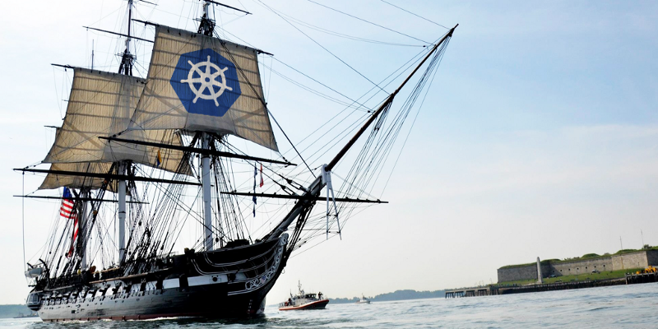
Using Kubernetes
Day 1
Nesia Amit

Slide 2
Agenda
Microservices Architecture
Microservices Architecture
What is Kubernetes?
Kubernetes Basics
Kubernetes Concepts

Slide 3
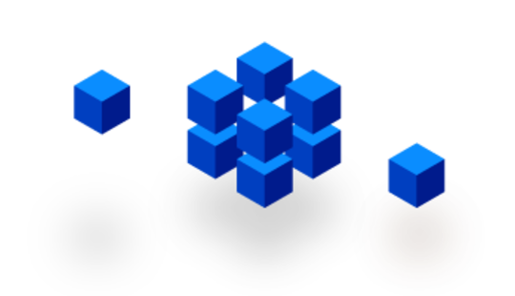
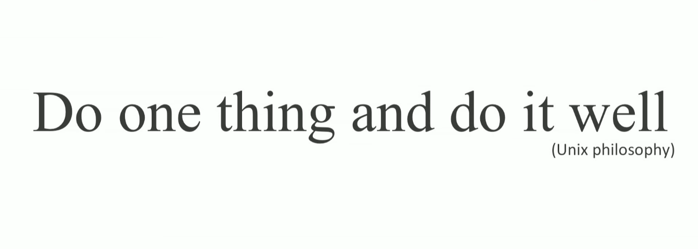
Microservices

Slide 4
Typical MVC Application
User Interface
ProjectView
What if the application keeps growing?
- render
Business-Logic
ProjectController
LoginController
show
create
- user
Data Layer
Project
name
orders
User
username
password
DB

Slide 5
Typical MVC Application
User Interface
FileView
OrderView
AccountView
ProjectView
Adding more and more functionality until…
- render
- render
- render
- render
Business-Logic
FileLoader
AcctController
Auth
OrderController
ProjectController
LoginController
createOrder
showOrder
- account
- user
- permissions
createOrder
showOrder
show
create
- user
Data Layer
File
Order
Account
Permissions
Project
path
content
type
account
id
user
role
permissions
name
orders
User
username
password
FS
DB

Slide 6
Monolithic Architecture
User Interface
FileView
OrderView
AccountView
ProjectView
It becomes a massive monolith that is almost impossible to maintain and eats way too much CPU and RAM.
- render
- render
- render
- render
Business-Logic
FileLoader
AcctController
Auth
OrderController
ProjectController
LoginController
createOrder
showOrder
- account
- user
- permissions
createOrder
showOrder
show
create
- user
Data Layer
File
Order
Account
Permissions
Project
path
content
type
account
id
user
role
permissions
name
orders
User
username
password
FS
DB

Slide 7
Monolithics Limitations
Application too large and complex to fully understand
Impact of a change usually not predictable
Bug in one module (e.g. memory leak) could potentially bring down the entire application
On each update – need to redeploy the entire application.
Barrier in adopting new technologies or frameworks
Size of application increase build time and slows down start-up time.
Continues deployment is difficult.

Slide 8
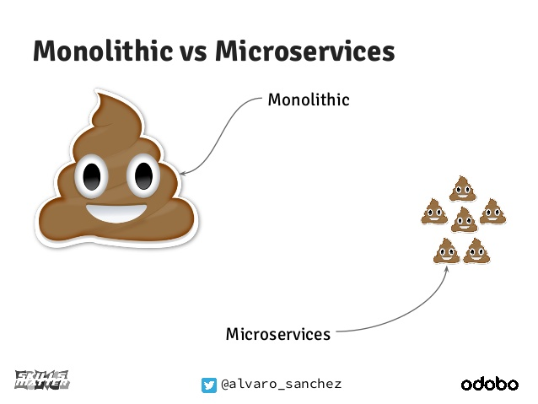

Slide 9
Split the application into smaller chunks
User Interface
Business-Logic
Data Layer
DB
FS

Slide 10
Split the application into smaller chunks
File-Service
User Interface
Mgmt
Orders-Service
Account-Service
Auth
Notofication-Service
Payment-Service
FS
DB
DB
DB
DB

Slide 11
Split the application into smaller chunks
User Interface
http
http
http
File-Service
http
Mgmt
http
Orders-Service
http
Auth
Notofication-Service
Account-Service
Payment-Service
FS
DB
DB
DB
DB

Slide 12
Host-centric Infrastructure
User Interface
http
=
The old way to deploy applications
heavyweight, non-portable, Relies on OS package manager
http
http
File-Service
http
Mgmt
http
Orders-Service
http
Auth
rails
sinatra
vanila
rails
State-machines
Notofication-Service
Account-Service
Payment-Service
bundler
rails
unicorn
sidekiq
Binaries/Libraries
libyaml
libxslt
libicu
Ruby
Node
npm
Java
FS
DB
DB
DB
DB
libssl
libxml
libpq
Mysql-Client
Redis-tools
Host Operating System Kernel

Slide 13

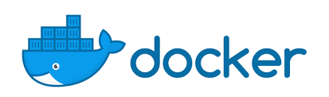
Container-centric Infrastructure
User Interface
Bin/Lib
Mgmt
http
http
Bin/Lib
=
The new way to deploy applications
Small and fast, portable, Uses OS-level virtualization
File-Service
http
http
http
Bin/Lib
Auth
Orders-Service
Bin/Lib
Bin/Lib
Account-Service
Payment-Service
Bin/Lib
Bin/Lib
Docker Engine or (rkt)
Binaries/Libraries
Host Operating System Kernel

Slide 14
Containers Benefits
Loosely coupled, distributed, elastic, liberated micro-services
Application-centric management
Environmental consistency across development, testing, and production
Continuous development, integration, and deployment
Resource isolation

Slide 15
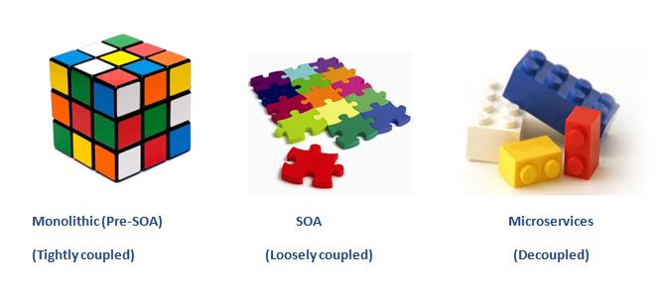
Monolithic – Service Oriented - Microservices

Slide 16
Agenda
A microservice is an isolated, loosely-coupled unit of development that works on a single concern.
Microservices Architecture
What is Kubernetes?
What is Kubernetes?
Kubernetes Basics
Kubernetes Concepts

Slide 17
First, Microservices Challenges…

Slide 18

VM#3
VM#1
VM#2

Slide 19
Challenge 1:
Auto Deploy
Auto Scale
VM#3
VM#1
VM#2

Slide 20
Challenge 2:
Load Balancing
VM#3
VM#1
VM#2

Slide 21
Challenge 3:
Service Discovery
red:1880
VM#3
VM#1
VM#2

Slide 22
Challenge 4:
Zero Downtime deploys
VM#3
VM#1
VM#2

Slide 23
Challenge 5:
Health Checks
VM#3
VM#1
VM#2

Slide 24
Challenge 6:
Distribute Configuration and Secrets
VM#3
VM#1
VM#2

Slide 25
Challenge 7:
Storage Management
VM#3
VM#1
VM#2

Slide 26
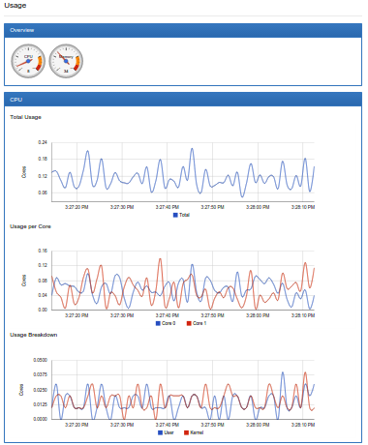
Challenge 8:
Monitoring Resources
VM#3
VM#1
VM#2

Slide 27
How can we meet the challenges?

Slide 28

Containers Orchestrator
The main players:
Kubernetes
AWS ECS
Docker Swarm
Kubernetes has the largest community and is the most popular by a big margin

Slide 29
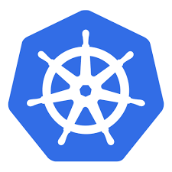
Kubernetes (aka. K8s)
Kubernetes is an open-source started in 2014 by Google.
Community includes Google, Red Hat, and over 2000 authors. (Source: CNCF)
The name Kubernetes originates from Greek, meaning helmsman

Slide 30
Agenda
A microservice is an isolated, loosely-coupled unit of development that works on a single concern.
Microservices Architecture
Kubernetes is an open-source platform designed to automate deploying, scaling, and operating application containers.
What is Kubernetes?
Kubernetes Basics
Kubernetes Basics
Kubernetes Concepts

Slide 31
Pod - the basic building block of Kubernetes
IP address
10.10.10.2
Containerized app
VM#3
VM#1
VM#2

Slide 32
Pod
A Pod represents a unit of deployment:
a single instance of an application in Kubernetes
The Pod might consist of either a single container or a small number of containers that are tightly coupled and that share resources.

Slide 33
Master
Pod
Kube-apiserver
etcd
Kube-scheduler
Kube-controller-manager
Docker
kublet
kublet
Docker
Node
Node Processes
Kubernetes Cluster
kublet
Docker

Slide 34
Pod
Pods are designed as relatively ephemeral, disposable entities.
Pods are managed in Kubernetes via Controllers

Slide 35
Controller
A Controller can create and manage multiple Pods for you, handling replication and rollout and providing self-healing capabilities at cluster scope.
Some examples of Controllers:
Deployment
StatefulSet
DaemonSet

Slide 36
Master
Pod
Deployment
D
D
D
Docker
kublet
kublet
Docker
Node
Node Processes
Kubernetes Cluster
kublet
Docker

Slide 37

kubectl run my-app …
D
Master
Node#3
Docker
kublet
Node#1
kublet
Docker
Node#2
Kubernetes Cluster
kublet
Docker

Slide 38
web-service :80
Lets-Chat-Web
(Nginx)
Lets-Chat-Web
(Nginx)
Lets-Chat-Web
(Nginx)
app-service :8080
Lets-Chat-App
(Node.js)
Lets-Chat-App
(Node.js)
Lets-Chat-App
(Node.js)
web-service :27017
Lets-Chat-DB
(MongoDB)

Slide 39
Working with kubectl Imperative Commands
Deploy and Explore an Application (Lab: task-1)
# create a Deployment called ‘my-app’ which starts
# a single pod with nginx container listening on port 80
$ kubectl run my-app --image=nginx --port=80
# list all pods
$ kubectl get po
# stream pod logs (stdout)
$ kubectl logs –f my-app-pod-name
# run command in a pod
$ kubectl exec –it my-app-pod-name bash
# forward port 80 of pod to port 10080 on your local machine
$ kubectl port-forward my-app-pod-name 10080:80

Slide 40
kubectl expose deploy …
10.30.0.2:5672
10.40.0.2:80
D
D
Master
10.97.14.200:5673
10.105.128.60:8080
Node#3
S
S
kublet
Docker
Node#1
kublet
Docker
10.32.0.3:5672
10.43.0.2:80
Node#2
Kubernetes Cluster
kublet
Docker

Slide 41
Service
A Service routes traffic across a set of Pods
The set of Pods targeted by a Service is usually determined by a LabelSelector
A Service is an abstraction that allow pods to die and replicate in Kubernetes without impacting your application.
Discovery and routing among Pods is handled by Kubernetes Services.

Slide 42
Working with kubectl Imperative Commands
Expose and Scale your Application (Lab: task-2)
# Create a service for my-app deployment, on port 80 and connects to the containers on port 8000.
$ kubectl expose deployment my-app --port=80 --target-port=8000
# List all services
$ kubectl get svc
# List pods and show all labels as the last column
$ kubectl get po --show-labels
# Scale a deployment named 'foo' to 3.
$ kubectl scale deploy my-app --replicas=3

Slide 43
Agenda
A microservice is an isolated, loosely-coupled unit of development that works on a single concern.
Microservices Architecture
Kubernetes is an open-source platform designed to automate deploying, scaling, and operating application containers.
What is Kubernetes?
Using kubectl imperative commands to Deploy, Explore, Expose, Scale your Application
Kubernetes Basics
Kubernetes Concepts
Kubernetes Concepts

Slide 44
Master Componets
kube-apiserver - exposes the Kubernetes API. It is the front-end for the Kubernetes control plane.
etcd - key value store used as Kubernetes’ backing store for all cluster data.
kube-scheduler - watches newly created pods that have no node assigned, and selects a node for them to run on.
kube-controller-manager –
Responsible for noticing and responding when nodes go down.
Responsible for maintaining the correct number of pods for every replication controller object in the system.
Populates the Endpoints object (that is, joins Services & Pods).

Slide 45
Node Components
Kubelet - An agent that runs on each node in the cluster. It makes sure that containers are running in a pod.
Container Runtime - is the software that is responsible for running containers. Kubernetes supports two runtimes: Docker and rkt.
kube-proxy - enables the Kubernetes service abstraction by maintaining network rules on the host and performing connection forwarding.
DNS - a DNS server, which serves DNS records for Kubernetes services

Slide 46
Defining a Service
A Service is Kubernetes API object.
Its definition can be POSTed to the apiserver to create a new instance.
This specification will create a new Service object named “my-service” which targets TCP port 80 on any Pod with the "app=MyApp" label.
my-service.yaml
kind: Service
apiVersion: v1
metadata:
name: my-service
spec:
selector:
app: MyApp
ports:
- protocol: TCP
port: 8080
targetPort: 80
# Create a service from a file.
$ kubectl create –f my-service.yaml

Slide 47
Endpoints
Once a Service object with selector is created, it will be assigned with virtual IP and – a corresponding Endpoints object is also created.
kind: Service apiVersion: v1 metadata: name: my-service spec:
clusterIP: 10.106.92.105
selector: app: MyApp ports: - protocol: TCP port: 8080 targetPort: 80
kind: Endpoints apiVersion: v1 metadata: name: my-service
labels:
app: MyApp
subsets: - addresses: - ip: 10.10.10.2
- addresses: - ip: 10.10.10.3
ports: - port: 80
10.10.10.2:80
my-app
kubelet
Dock
10.10.10.3:80
my-app
kubelet
Dock

Slide 48
kube-proxy on every Node, is notified on new Service and Endpoints Objects:
Etcd
kubelet
Dock
kubelet
Dock
10.10.10.2:80
my-app
kube-proxy
Iptables for service (with virtual ip) and endpoints
-A KUBE-SEP-57K ...
-A KUBE-SEP-5RZ ….
-A KUBE-SERVICES ….
-A KUBE-SVC-NW ...
-A KUBE-SVC-NV5 ….
kubelet
Docker

Slide 49
Discovering Services – kube-dns
The DNS server watches the Kubernetes API for new Services and creates a set of DNS records for each.
If DNS has been enabled throughout the cluster then all Pods should be able to do name resolution of Services automatically.

Slide 50
Defining a Deployment
my-deploy.yaml
apiVersion: apps/v1beta2
kind: Deployment
metadata:
name: nginx-deployment
labels:
app: nginx
spec:
replicas: 3
selector:
matchLabels:
app: nginx
template:
metadata:
labels:
app: nginx
spec:
containers:
- name: nginx
image: nginx:1.7.9
ports:
- containerPort: 80
A Deployment controller provides declarative updates for Pods and ReplicaSets
Using kubectl declarative command:
# Create a deployment from a file.
$ kubectl create –f my-deploy.yaml

Slide 51
Set Environment Variable to the Pod Container
spec:
containers:
- name: nginx
image: nginx:1.7.9
ports:
- containerPort: 80
env:
- name: DEMO_GREETING
value: "Hello from the environment"
Add to spec.containers.env list of desired environments variables
# Run command on pod container.
$ kubectl exec -it my-pod-name -- env | grep DEMO_GREETING

Slide 52
Agenda
A microservice is an isolated, loosely-coupled unit of development that works on a single concern.
Microservices Architecture
Kubernetes is an open-source platform designed to automate deploying, scaling, and operating application containers.
What is Kubernetes?
Using kubectl imperative commands to Deploy, Explore, Expose, Scale and Update your Application
Kubernetes Basics
Understanding how Kubernetes works with Deployments, Services and Pods
Kubernetes Concepts

Slide 53
Coming Next:
ConfigMap and Secrets
Volumes
Ingress and Nginx-Controller
PersistentVolumes
StatefulSet
Helm-Charts

